Slide 1
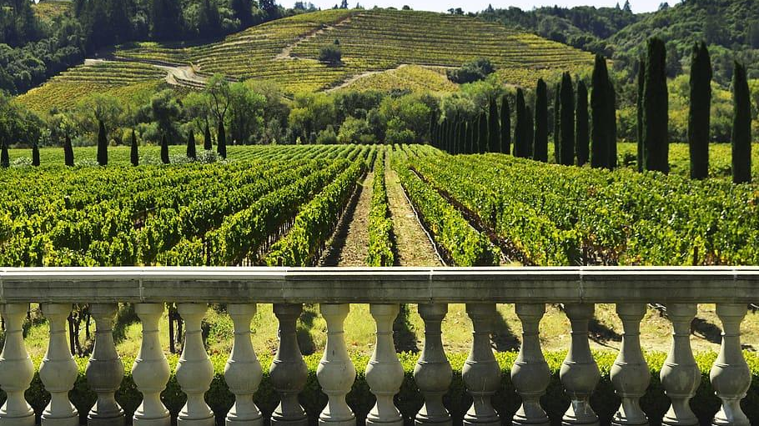
Group 3: Bacchus Winery Case Study
Mikaela June
Robert Minkler
Ian Lewis
Hector Lara
CSD 310

Slide 2
Bacchus Winery Case Study
Stan and Davis Bacchus inherited their fathers winery where they grow grapes to produce a Merlot, a Cabernet, a Chablis, and a Chardonnay. The winery’s yearly business “snapshot” is due soon and the brothers are looking for information to determine the state of their inventory, the distribution needs, and their employees. Our goal is to determine the employees time history with hours worked per quarter, analyze the type and amount of wine purchased by each distributor, determine the amount of on-time versus late deliveries on average, and to display the amount each wine has sold within the year.

Slide 3
Group 3 Process
Group 3 built our schema, SQL queries, and reports through an iterative process. We began with a simplified ERD and business rules, then expanded it considerably as we broke down all the data that was necessary for our reporting and storage requirements. As we were building our reports, we allowed for small changes to the schema to accommodate our reports. We have a database initialization script that will drop the database and rebuild it from scratch, adding a custom winery user. We have a sample data insertion script that populates the database with all the required test data. We then have our reports script that queries the database to build our reports and outputs them to the console.

Slide 4
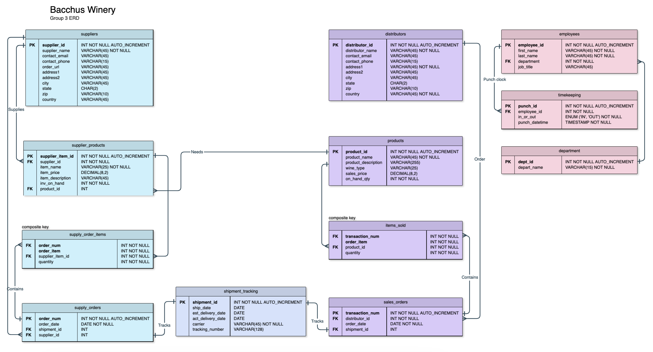

Slide 5

Breakdown of Bacchus Winery Reports

Slide 6
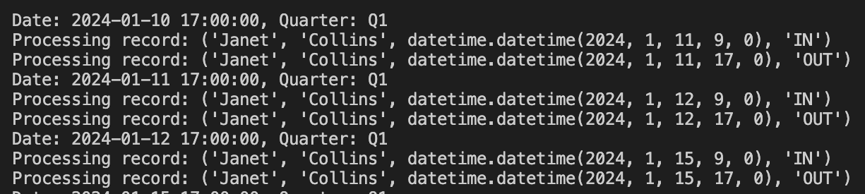
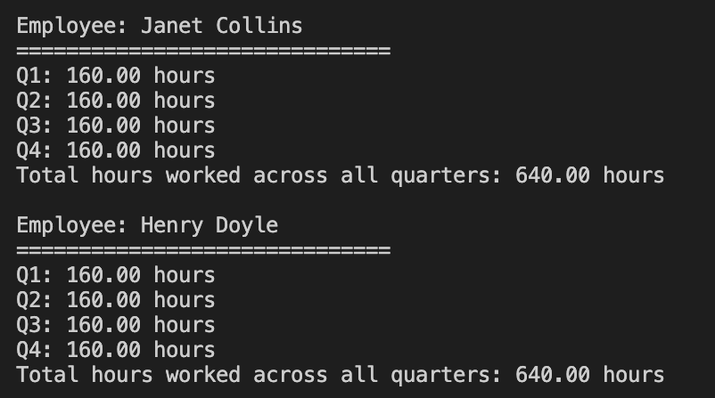
Report 1:
Employee Data
The goal of Report 1 is to determine employee time history by showing each employee and how many hours they worked each quarter for the last four quarters.
This includes the addition of “in” and “out” time punches across all four quarters.

Slide 7
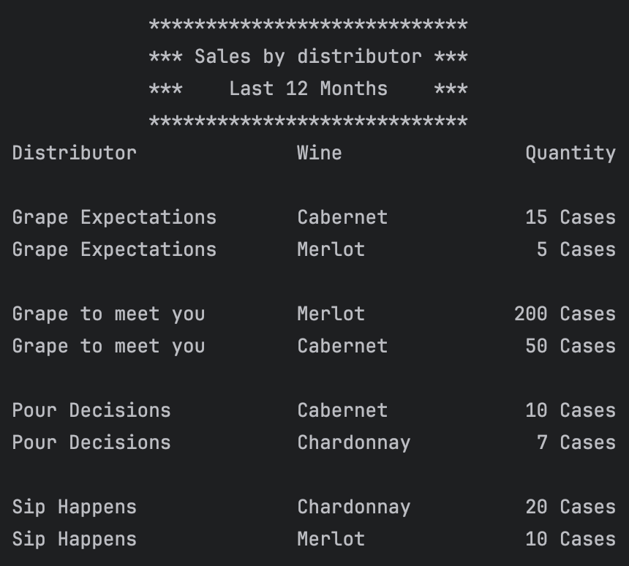
Report 2:
Sales Data
Bacchus Winery management wants to understand which wines are selling and which distributors carry which wines. This report gives a breakdown of distributor sales by each wine so they can see who is selling which wine. This report uses a view to join data from four tables to simplify the SQL.

Slide 8
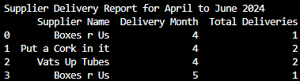
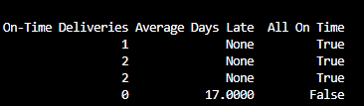
Report 3:
Supplier Delivery
Report Results
My goal for report 3 was to display the suppliers, the month they delivered their products, their total deliveries, the amount of on-time deliveries, the amount of late deliveries, and the average days the deliveries were late.

Slide 9
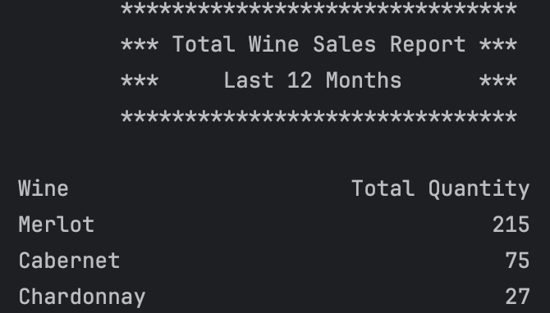
Report 4:
Total Wine Sales
Report Results
Report 4 was a way to see how many cases of Wine had been sold in the last 12 months.

Slide 10
Assumptions
All employees will punch in & out regardless of if they are Hourly or Exempt to determine hours worked.
Hired employees work Monday to Friday, 9am to 5pm, 40 hours per week, and 160 hours per quarter.
Bacchus Wines only sells b2b.
All shipping has tracking information.
All orders can be fulfilled with one shipment.
Additional reports will be necessary in the future as management determines.
They do not currently have product ID’s or UPC’s to track their products.

